Slide 1
Programming in Python
By
Dr. Anjali Garg
Asso. Prof. ( Dept. of Comp. App.) , GNIMT, Ludhiana
Email: anjali.garg73@gmail.com

Slide 2
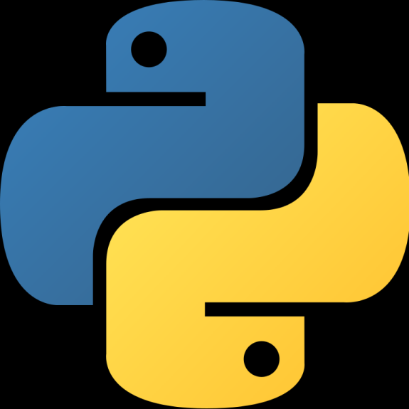

Python was developed in 1989
by
Guido Van Rossum

Slide 3
Why the name Python?
Not after a dangerous snake.
Rossum was fan of a comedy series from late seventies.
The name "Python" was adopted from the same series "Monty Python's Flying Circus".

Slide 4
Why should you learn Python?

Slide 5
Python Applications
Web Development
Game Development
Machine Learning and Artificial Intelligence
Data Science and Data Visualization
Desktop GUI
Web Scraping Applications
Business Applications
Audio and Video Applications
CAD Applications
Embedded Applications

Slide 6
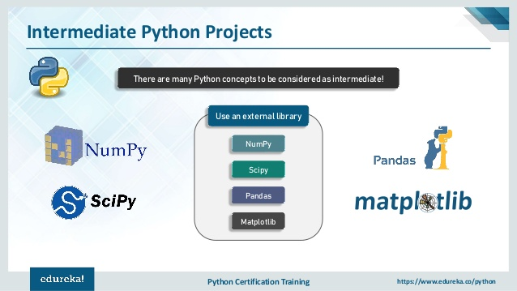
Numpy and Scipy – fundamental scientific computing.
Pandas – data manipulation and analysis.
Matplotlib – plotting and visualization.
Scikit-learn– machine learning and data mining.

Slide 7
Scope
Python is General purpose programming language
Python is used in engineering field to develop Web Application(like: Django and Bottle)
Used by data scientists to analyse large amount of data (NumPy, Pandas)
To develop graphical user Interfaces (Pygame, Panda3D), network security and many more applications.
Image processing applications can be developed using scikit-image library
Develop IOT applications using Arduino and Raspberry pi

Slide 8
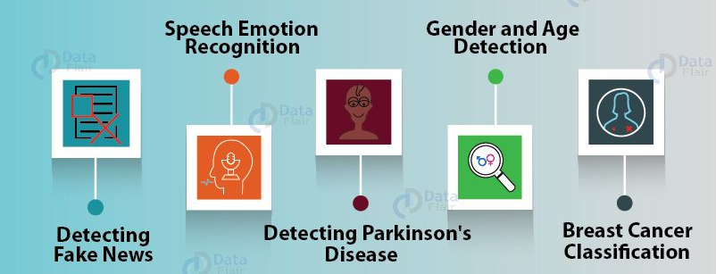
Python Projects….

Slide 9
IoT PROJECTS
Weather Reporting System
Facial Recognition Door Unlock
Fire Detection System
IoT Based Smart Mirror
Smart Parking System using IoT

Slide 10
DEEP LEARNING PROJECTS
Image Classification
Dog’s Breed Identification
Gender Recognition Using Voice
Human Activity Recognition with Video Classification

Slide 11
Data Science PROJECTS
Driver Drowsiness Detection
Movie Recommendation System
Traffic Signs Recognition
Image Caption Generator
Handwritten Digit Recognition

Slide 12
Introduction to Python
Python is a high-level programming language
Open source and community driven
Dynamic typed
Source can be compiled or run just-in-time
Object Oriented Language
Interpreted Language

Slide 13
Python Implementations
The standard implementation of Python is called CPython. It is written in C.
There are different implementations such as Jython, IronPython, Stackless and PyPy.
Jython: It was originally known as Jpython. It is used to run programs on Java platform (https://www.jython.org)
IronPython: It is an open source implementation of Python for the .Net framework. A major used of this is to embed .net applications. (https://www.ironpythonPython.net)
Stackless Python: When a program is run on stackless Python then program is split into multithreads. (www.stackless.com)
PyPy: Here Python interpreter is written in Python itself. It focuses on speed, efficiency and compatibility. It is 4.4 times faster than Cpython. (www.pypy.org)

Slide 14
Internal working of python
Syntax checker and Translator
Python code
Byte code
Python Virtual Machine(PVM)
Input
Program Output

Slide 15
Installation of Python in Windows
Go to Download Python page on the official site (https://www.python.org/downloads) and click Download Python
(You may see different version name)
When the download is completed, double-click the file and follow the instructions to install it.
When Python is installed, a program called IDLE is also installed along with it. It provides graphical user interface to work with Python.

Slide 16
Open IDLE, Write the following code below and press enter.
print("Hello, World!")
To create a file in IDLE, go to File > New Window (Shortcut: Ctrl+N).
Write Python code and save (Shortcut: Ctrl+S) with .py file extension like: hello.py or your-first-program.py
print("Hello, World!")
Go to Run > Run module (Shortcut: F5) and you can see the output.

Slide 17
First Python Program
# first program ‘first.py’ to add two numbers
a=2
b=3
sum=a+b
print('sum =',sum)
print( 'sum of {0} and {1} is {2}'.format(a,b,sum))
=============== RESTART: C:/Users/home/Desktop/python/first.py ===============
sum = 5
sum of 2 and 3 is 5
>>>

Slide 18
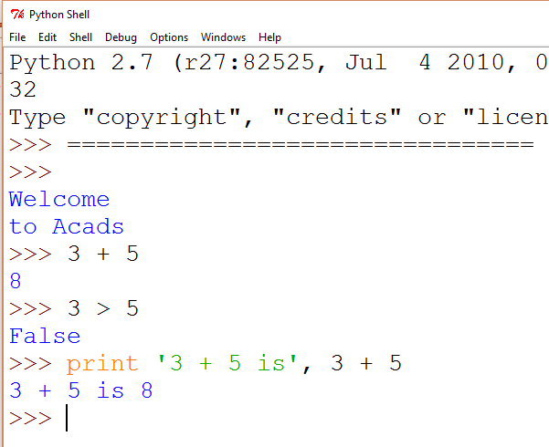
Python Shell is Interactive
IN[1]:
User Commands
(Statements)
IN[2]:
IN[3]:
(
)
Outputs

Slide 19
Interacting with Python Programs
Python program communicates its results to user using print
Python 3 uses input to read user input as a string (str)

Slide 20
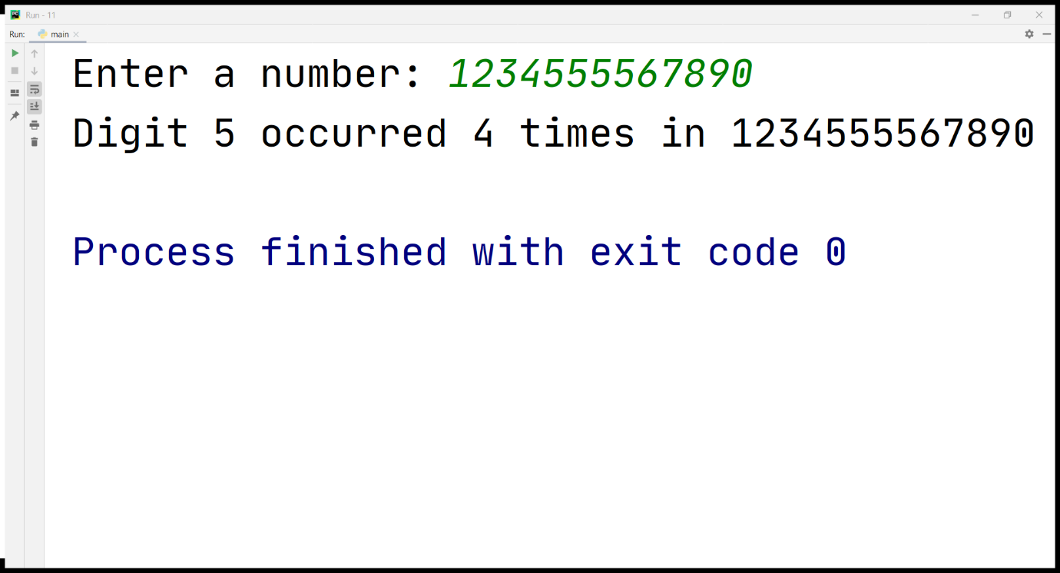

Slide 21
Few Important Things to Remember
To represent a statement in Python, newline (enter) is used.
Use of semicolon at the end of the statement is optional (unlike languages like C/C++)
In fact, it's recommended to omit semicolon at the end of the statement in Python
Instead of curly braces { }, indentations are used to represent a block

Slide 22
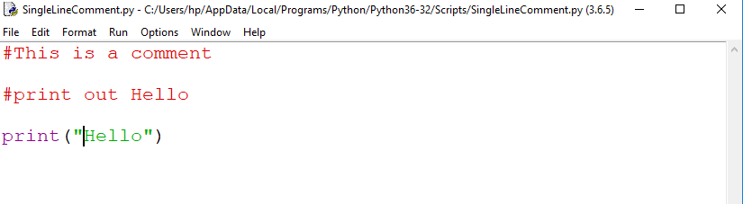
Commenting in Python
To make the code much more readable.
Python Interpreter ignores comment.
Python single line comment preceded by a hash symbol (#)
Three consecutive single quotation marks ‘’’ are used to give multiple comments (or) paragraph comments.

Slide 23
Comments
Multi Line Comments
Version-1
#To find sum of two numbers
#This is multi-line comments
#One more commented line
●
Version-2
4 """
This is first line
This second line
Finally comes third 8 """
Version-3
4 '''
This is first line
This second line
Finally comes third 8 '''

Slide 24
Token
Python Tokens
Keywords
Variables / Identifiers
Operators
Literals
Delimiters

Slide 25
Python Indentation
Most of the programming languages like C, C++, Java use braces { } to define a block of code
Python uses indentation
A code block (body of a function, loop etc.) starts with indentation and ends with the first un-indented line

Slide 26
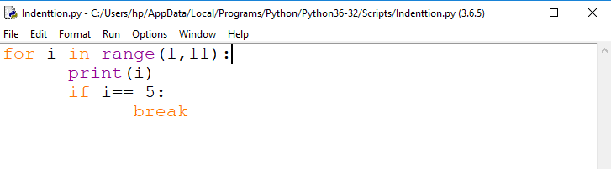
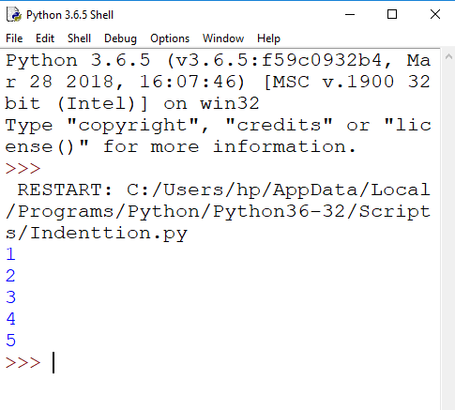

Slide 27
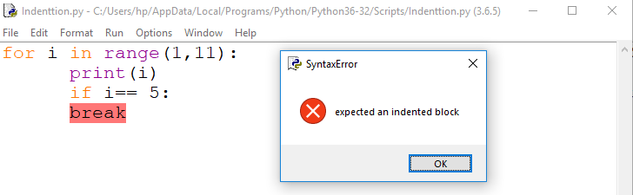
Error due to incorrect indentation

Slide 28
Python Variable
a variable is a named location used to store data in the memory.
Alternatively, variables are container that hold data which can be changed later throughout programming
In Python, variables do not need declaration to reserve memory space.
The "variable declaration" or "variable initialization" happens automatically when we assign a value to a variable.
We use the assignment operator = to assign the value to a variable.

Slide 29
Data-Types
All features in Pythons are associated with an object.
In python data types are classes and variables are instance (object) of these classes.
The native data types supported by Python are string, integer, float and complex numbers.
Different types of data types in python are:
Python numbers
Python lists
Python tuples
Python strings
Python sets
Python dictionary

Slide 30
Data-Types
None Type
None data-type represents an object that does not contain any value
In Java, it is called as NULL Object
In Python, it is called as NONE Object
In boolean expression, NONE data-type represents ‘False’
Example:
a = None
type(a) will return NoneType

Slide 31
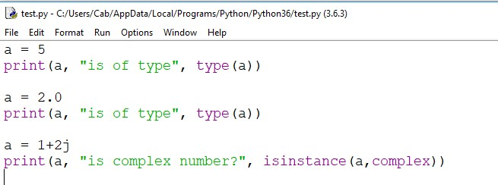
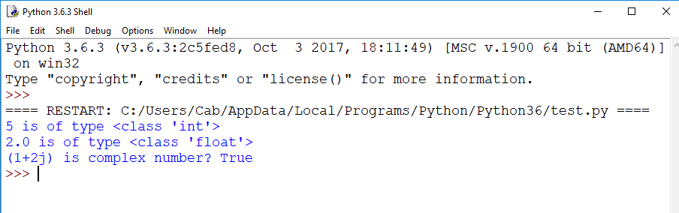
Python Numbers

Slide 32
Python List
Ordered sequence of items
Can contain heterogeneous data
Lists are mutable, meaning, value of elements of a list can be altered.
Syntax:
Items separated by commas are enclosed within brackets [ ]
Example: a= [1,2.2,'python']

Slide 33
The ‘in’ operator on List
The in operator: Determine whether an element is in a list or not.
Example:
>>> L1=['A','B','C',10,20,30]
>>> 30 not in L1
False
>>> 'D' in L1
False

Slide 34
List Comprehension
List Comprehension is used to create a new list form existing sequences.
Syntax:
[<expression> for <element> in <sequence> if <conditional>]
List1=[1,2,3,4,5] print(“content of list”, List1) List2=[x for x in List1 if x%2==1] print(“odd numbers from List1”, List2) Output: content of list [1, 2, 3, 4, 5] Odd numbers from List1 [1,3,5]

Slide 35
Splitting a String in List
The str class contains the split method.
It is used to split the string into words.
Example:
>>> L1 = "Welcome to Python Programming"
>>> L1.split()
['Welcome', 'to', 'Python', 'Programming']

Slide 36
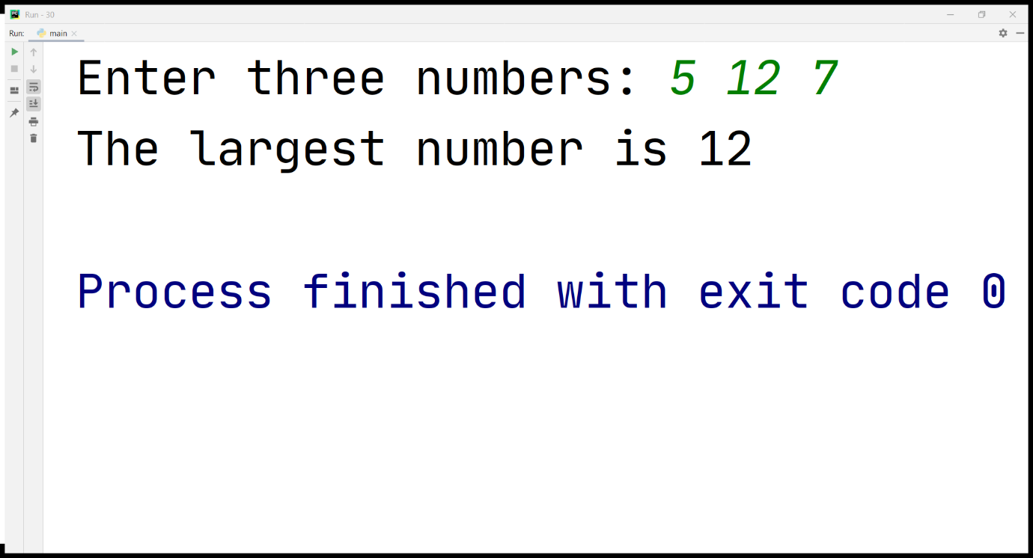

Slide 37
# Program to add two matrices ( result= X+Y) using nested loops X and Y are of # 3x3 matrix
X = [[12,7,3], [4 ,5,6], [7 ,8,9]]
Y = [[5,8,1], [6,7,3], [4,5,9]]
# result is 3x3
result = [ [0,0,0], [0,0,0], [0,0,0] ]
# iterate through rows of X
for i in range(len(X)):
# iterate through rows of Y
for j in range(len(Y)):
result[i][j] = X[i][j] + Y[i][j]
for r in result:
print(r)

Slide 38
Output???
str1="donald trumph" [print(i, end="") for i in str1 if i not in "aeiou"] Output: ??
list1=[[n,n+1,n+2] for n in range (0,3)] Print(list1) Output: ??

Slide 39
Tuples
Tuples contains a sequence of items of any types.
The elements of tuples are fixed.
Tuples are immutable, i.e. once created it cannot be changed.
In order to create a tuple the elements of tuples are enclosed in parenthesis instead of square bracket.
Example:
T2 = (12,34,56,90) #Create Tuple with 4 elements

Slide 40
Sorting elements of Tuple
Tuple does not support any sort method to sort the contents of Tuple.
Following are the steps required to sort the elements of Tuple.
a. Create Tuple
b. Convert Tuple to List
c. Use sort method of list
d. Convert back from list to tuple.
Example:
>>> t=(76,45,23,11) #Tuple
>>> t=list(t) #Converted Tuple to a List
>>> t.sort() #Sort method of List
>>> t=tuple(t) #Converting List to tuple
>>>print(t)
(11, 23, 45, 76)

Slide 41
Traverse Tuples from a List
A Tuple assignments can be used in the for loop to traverse a list of tuples.
Example:
>>> t=[(1,"manu"),(2,"anu")]
>>> for no, name in t:
print(no, name, sep=‘\t’)
Output:
1 manu
2 anu

Slide 42
Dictionaries
In python a dictionary is a collection that stores the values along with the keys.
The sequence of key and value pairs are separated by commas.
These pairs are sometimes called entries or item.
All entries are enclosed in curly braces { and }.
Example:
D= {'India': '+91', 'USA': '+1'}
Key Value Key Value

Slide 43
Program on Dictionary
Write a program to calculate number of positive and negative numbers of a list and display the count in dictionary.
Lst=[10,-3,23,-5]
D=dict()
D['Pos']=0
D['Neg']=0
for i in Lst:
if i<0:
D['Neg']+=1
else:
D['Pos']+=1
print (D)
Output: {'Pos': 2, 'Neg': 2}

Slide 44
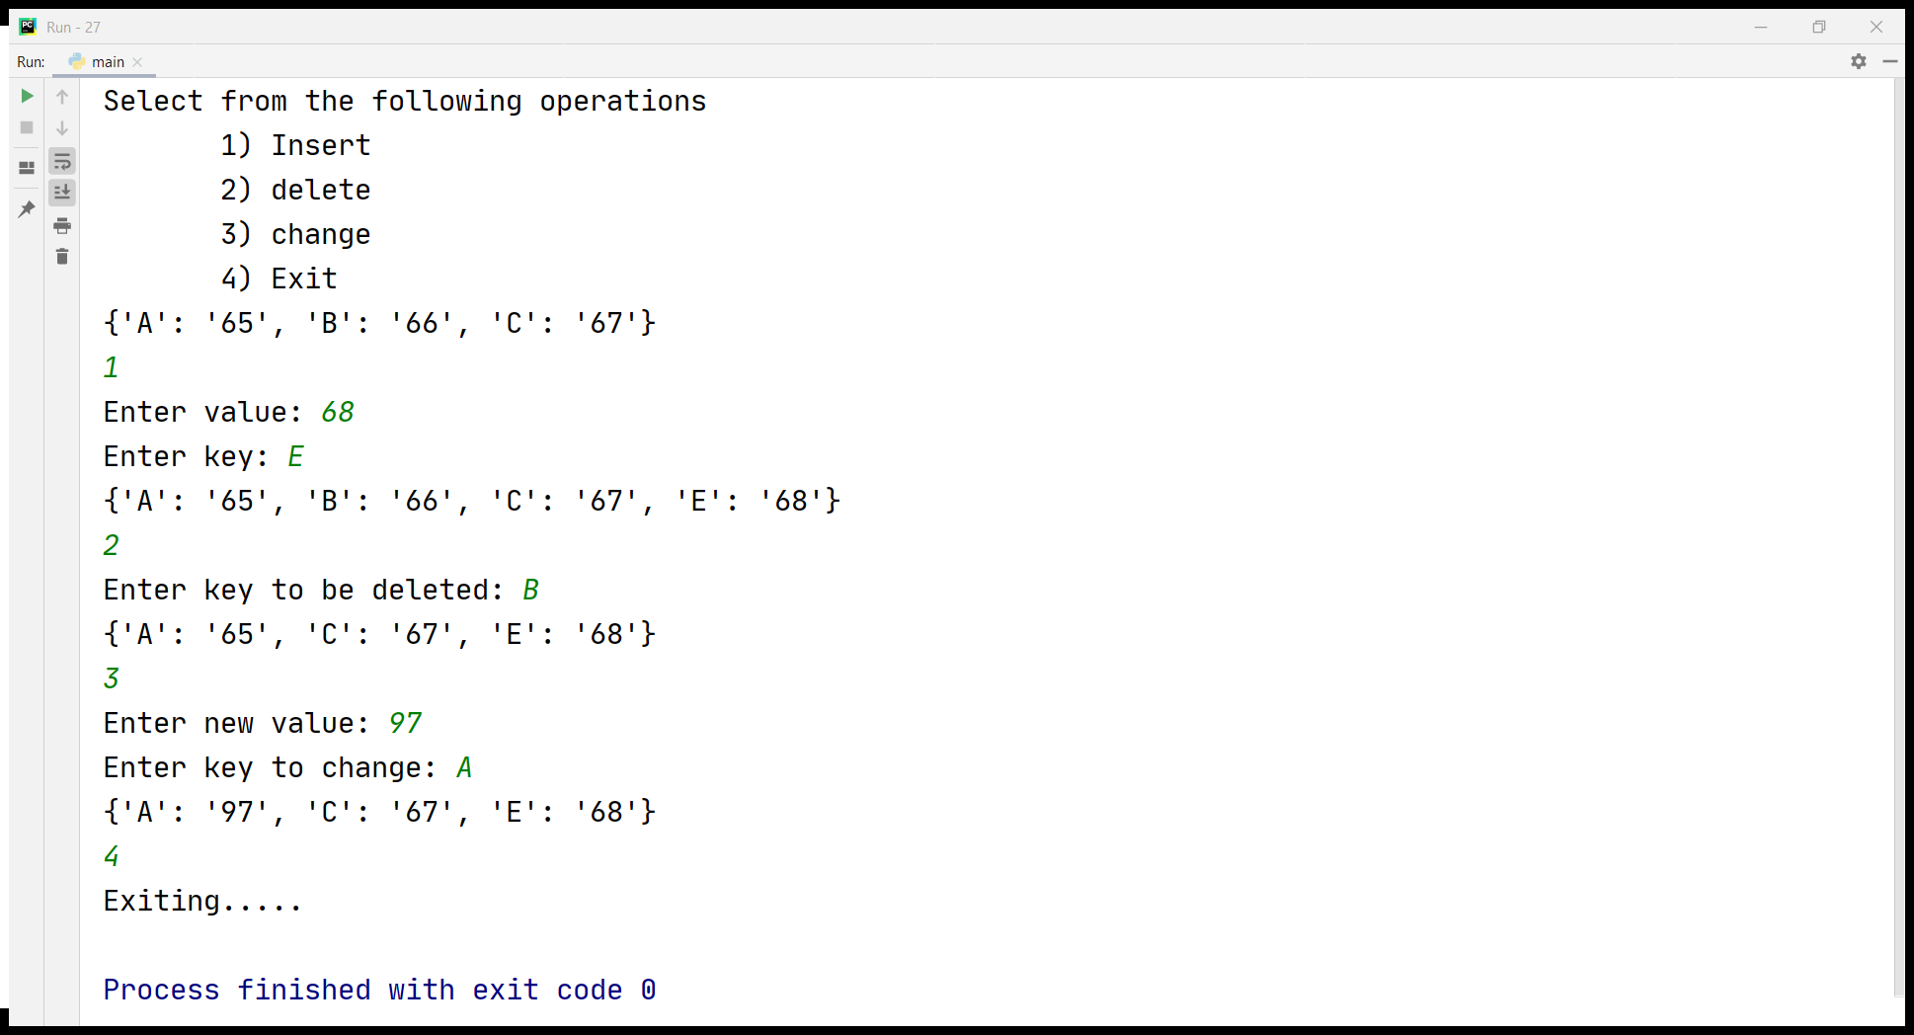

Slide 45
Program on Functions with Arguments and Parameters
Q. Write a program to calculate minimum of two numbers by making use of arguments and parameters.
def FindMin(num1,num2): if num1 < num2: print(num1, 'is smaller than ',num2) elif num2 < num1: print(num2,' is smaller than ', num1) else: print(' Both are equal') FindMin(20,40) Output: 20 is smaller than 40

Slide 46
ARBITRARY ARGUMENT LISTS
Variable-Length Arguments: more arguments than we specified while defining the function.
These arguments are also called variable-length arguments .
An asterisk (*) is placed before the variable name that holds the values of all non keyword variable arguments.
This tuple remains empty if no additional arguments are specified during the function call.
Syntax :
This is called arbitrary argument and asterisk sign is placed before the variable name.
def function_name([formal_args], *var_args_tuple ):
statement1…… statement 2……
return [expression]

Slide 47
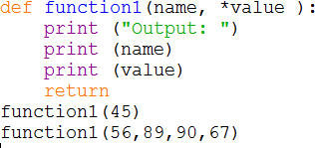
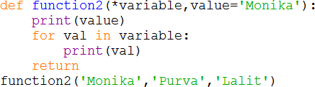
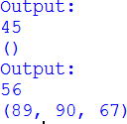
ARBITRARY ARGUMENT LISTS
EXAMPLE 1:
EXAMPLE 2:
Any formal parameter which occur after the *args parameter are keyword-only arguments.
If formal parameter are not keyword argument then error occurred.
Output:
Output: Monika
Monika
Purva
Lalit

Slide 48
Use of map()
org_list = [1, 2, 3, 4, 5]
# define a function that returns the cube of `num`
def cube(num):
return num**3
fin_list = list(map(cube, org_list))
print(fin_list) # [1, 8, 27, 64, 125]
Use of lambda
org_list = [1, 2, 3, 4, 5]
fin_list = list(map(lambda x:x**3, org_list))
print(fin_list) # [1, 8, 27, 64, 125]

Slide 49
Class
class complex1: # real+imag i
real=0
imag=0
def __init__(self, r, i):
self.real=r
self.imag=i
def calculate(self,obj1,obj2):
obj4=complex1(0,0)
print(' complex number1 is ', obj1.real , '+', obj1.imag,'i')
print(' complex number2 is ', obj2.real , '+', obj2.imag,'i')
obj4.real=obj1.real+obj2.real
obj4.imag=obj1.imag+obj2.imag
return obj4
obj1=complex1(10,20)
obj2=complex1(20,30)
obj3=complex1(0,0)
obj4=complex1(0,0)
obj4=obj3.calculate(obj1,obj2)
print(' addition of two complex numbers is= ', obj4.real , '+', obj4.imag,'i')
Output:
(' complex number1 is ', 10, '+', 20, 'i')
(' complex number2 is ', 20, '+', 30, 'i')
(' addition of two complex numbers is= ', 30, '+', 50, 'i')

Slide 50
Python Import
When our program grows bigger, it is a good idea to break it into different modules.
A module is a file containing Python definitions and statements.
Python modules have a filename and end with the extension .py
Definitions inside a module can be imported to another module or the interactive interpreter in Python
We use the import keyword to do this

Slide 51
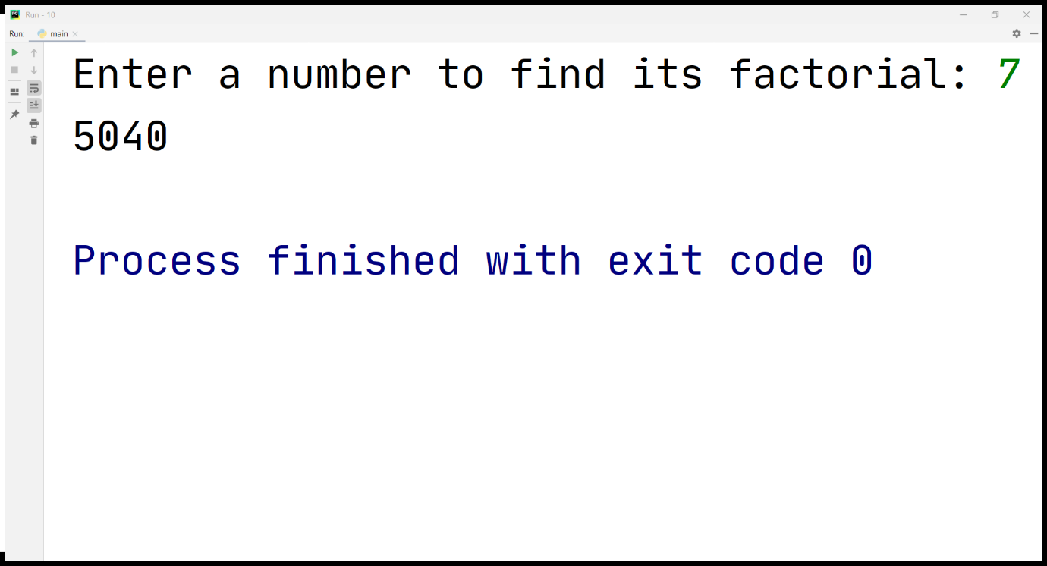

Slide 52
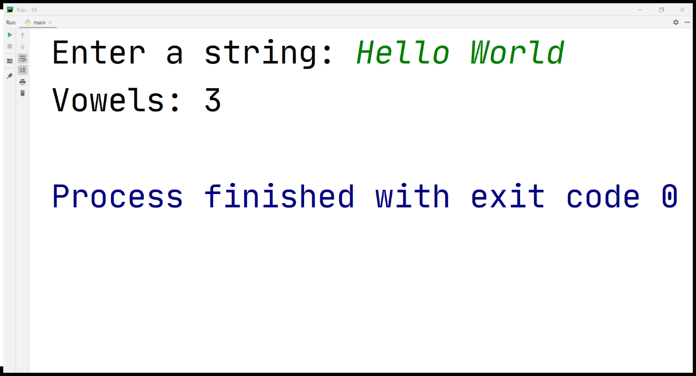

Slide 53
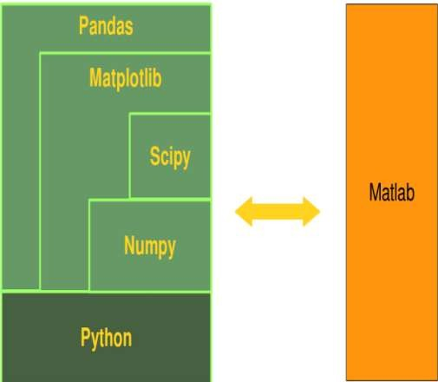
NumPy – A Replacement for MatLab
Python in combination with NumPy, Scipy and Matplotlib can be used as a replacement for MATLAB.
Matplotlib module provides MATLAB- like plotting functionality.

Slide 54
Core Python Vs NumPy
"Core Python", means Python without any special modules, i.e. especially without
NumPy.
Advantages of Core Python:
high-level number objects: integers, floating point
containers: lists with cheap insertion and append methods, dictionaries with fast lookup
Advantages of using NumPy with Python:
array oriented computing
efficiently implemented multi-dimensional arrays

Slide 55
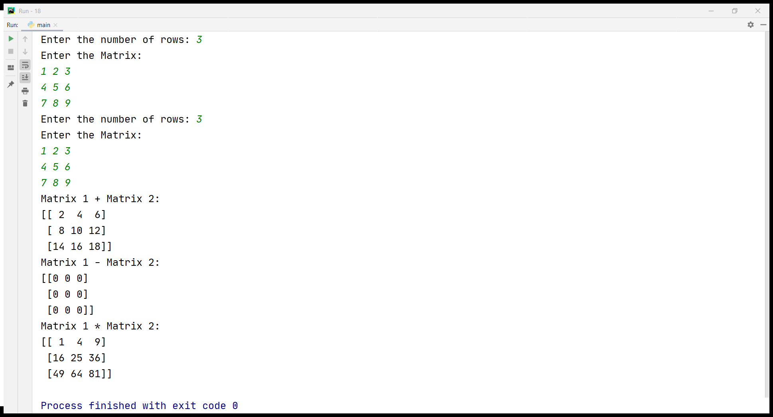

Slide 56
Data Handling using Pandas
Export Pandas DataFrame to a CSV File
e.g.
import pandas as pd
cars = {'Brand': ['Honda Civic','Toyota Corolla','Ford Focus','Audi A4'], 'Price': [22000,25000,27000,35000] }
df = pd.DataFrame(cars, columns= ['Brand', 'Price'])
df.to_csv ('C:/export_dataframe.csv', index = False, header=True)
print (df)

Slide 57
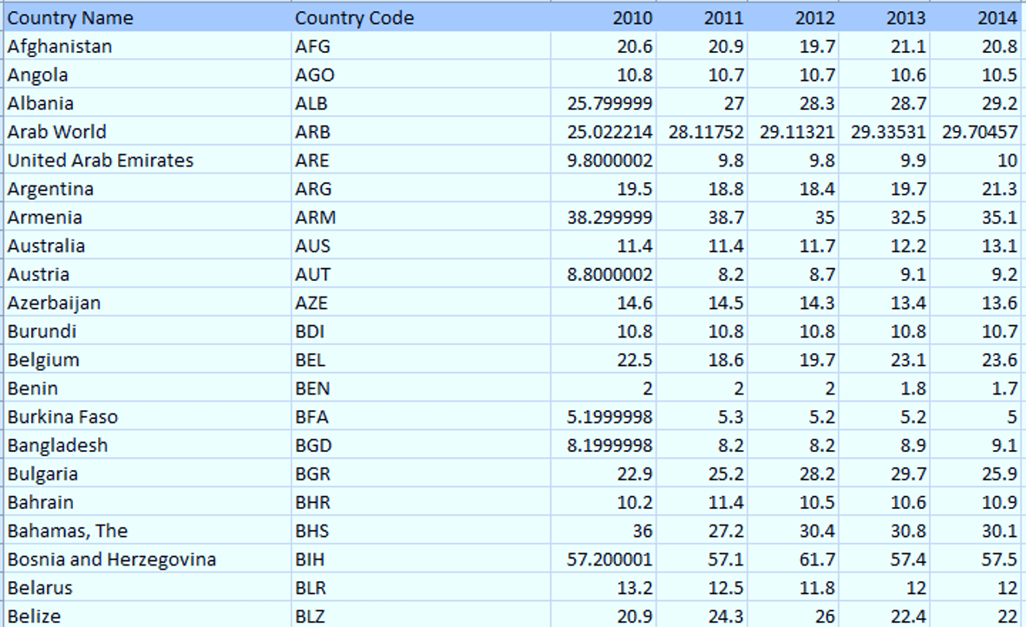
First, let us understand the dataset which contains the columns as Country Name, Country Code and the year from 2010 to 2014. Now using pandas, we will use “pd.read_csv” to read the .csv file format file.

Slide 58
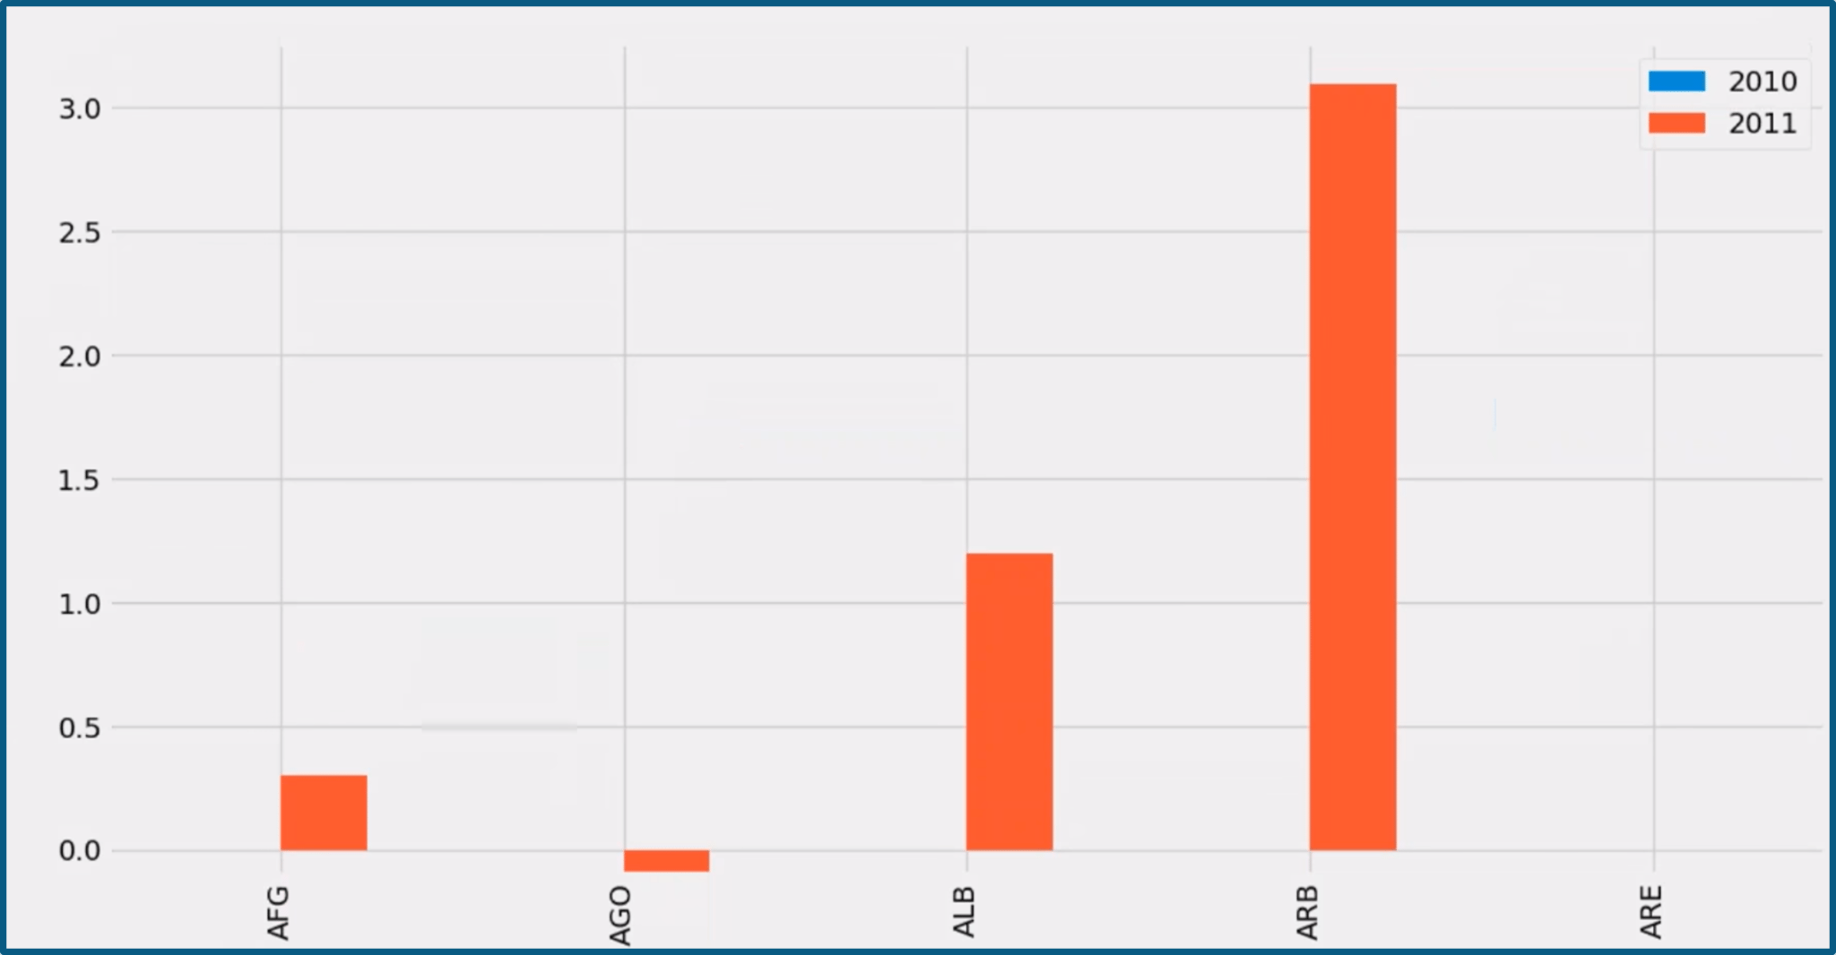
import pandas as pd
import matplotlib.pyplot as plt
from matplotlib import style
style.use('fivethirtyeight')
country= pd.read_csv("c:\users\home\appdata\Local\Programs\Python\Python37-32\Table105.csv",index_col=0)
country = country.iloc[:,1:] # all rows and columns from 2 to n
df= country.head(5)
df= df.set_index(["Country Code"])
sd = df.reindex(columns=['2010','2011'])
db= sd.diff(axis=1)
db.plot(kind="bar")
plt.show()

Slide 59
Contact me for Further Queries:
Dr Anjali Garg
9914513435
Anjali.garg73@gmail.com

